Slide 1

Socialite Business
Cyberpunkies

Slide 2
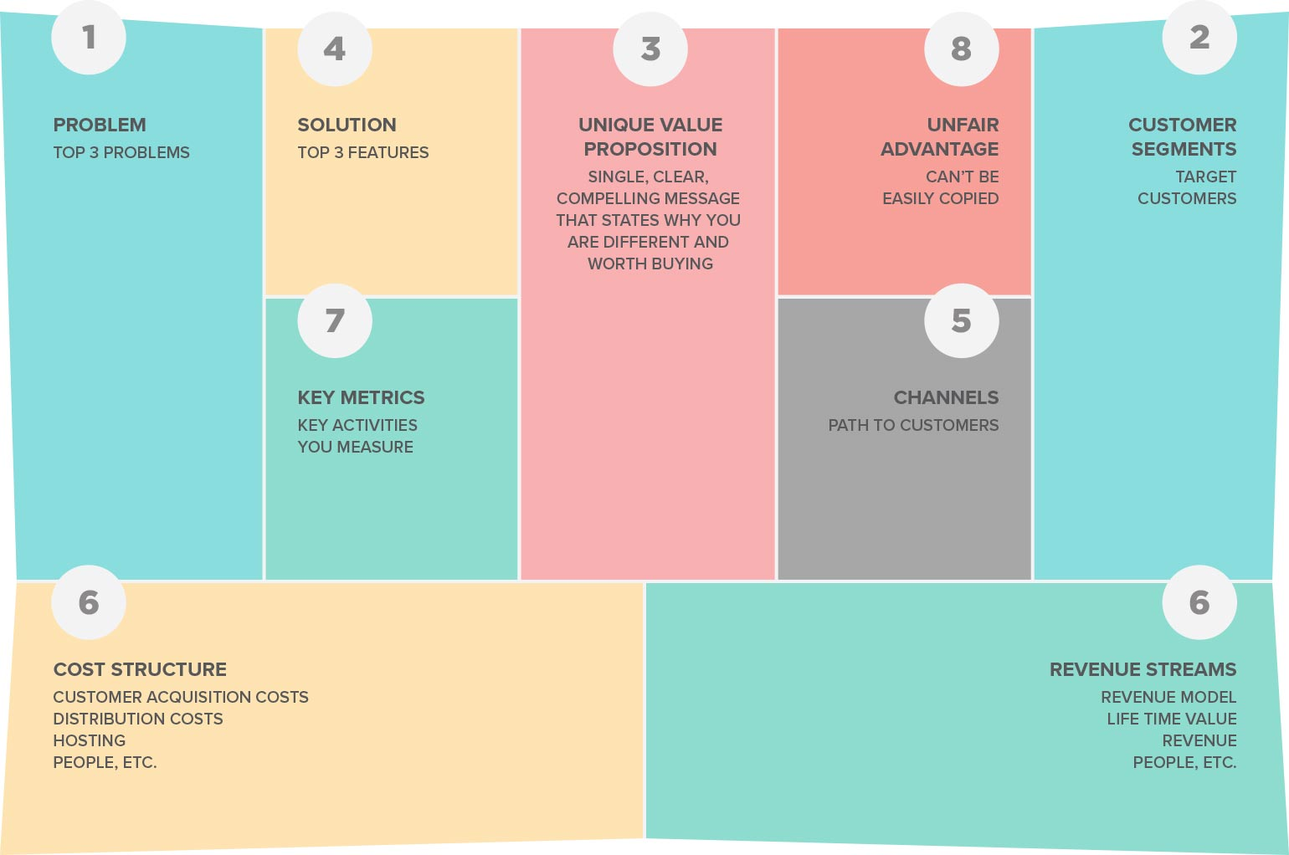




















Slide 3
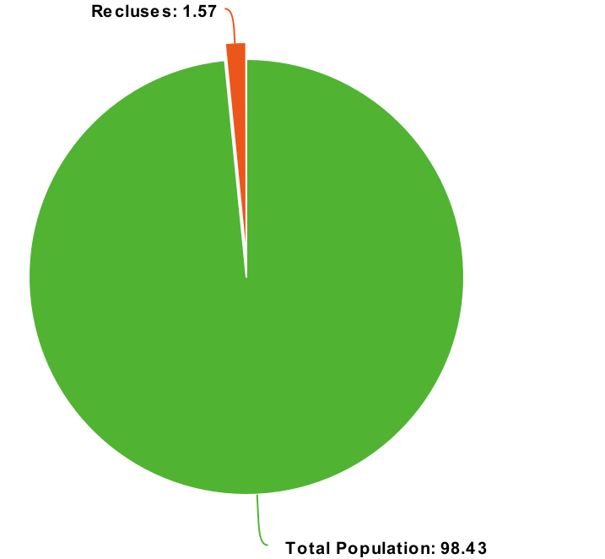
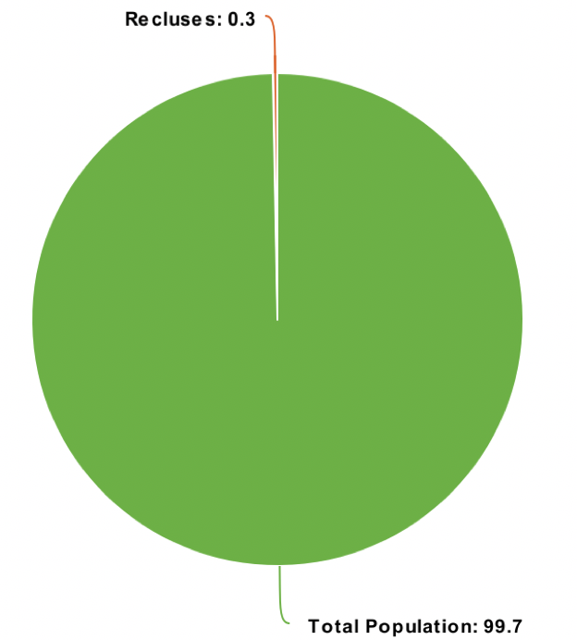
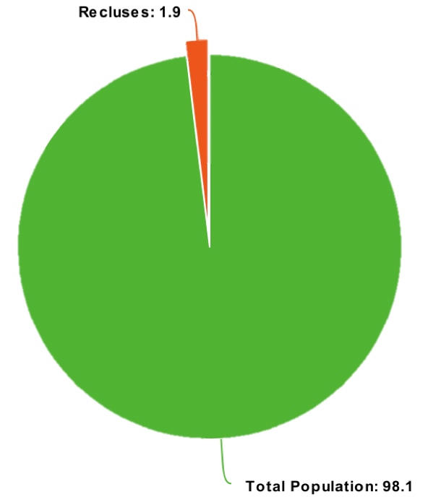



The Problem
Hermits: People who withdraw from the society dramatically increased in recently years.
Notes:
But in Japan half a million people live as modern-day hermits. They are known as hikikomori – recluses who withdraw from all social contact and often don’t leave their houses for years at a time. A government survey found roughly 541,000 (1.57% of the population) but many experts believe the total is much higher as it can take years before they seek help.
The condition was initially thought to be unique to Japan, but in recent years cases have appeared across the world. In neighbouring South Korea, a 2005 analysis estimated there were 33,000 socially withdrawn adolescents (0.3% of the population) and in Hong Kong a 2014 survey pegged the figure at 1.9%. It’s not just in Asia, cases are appearing in the US, Spain, Italy, France and elsewhere.

Slide 4
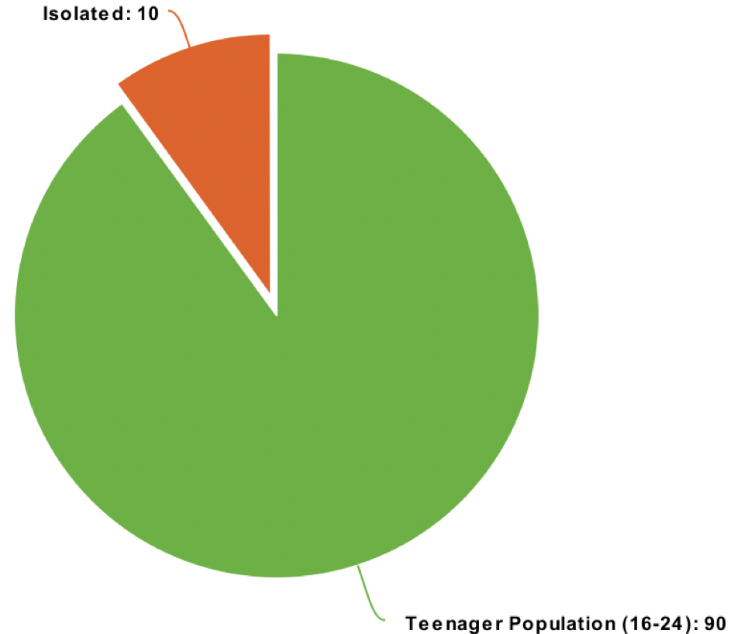

The Problem
Hermits are especially existing in the teenager population. This phenomenon is the most important factor to cause the shortage of labor.
Notes:
Whether due to increased awareness or a growing problem remains unclear, but concern around social isolation is on the rise globally. Last January the UK appointed its first minister for loneliness and recent Office of National Statistics data found nearly 10% of 16 to 24-year-olds reported feeling "always or often" lonely.

Slide 6
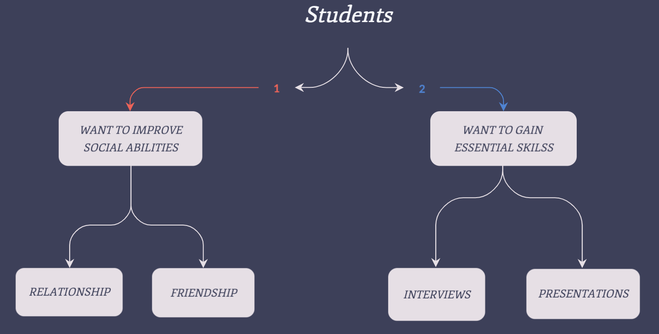
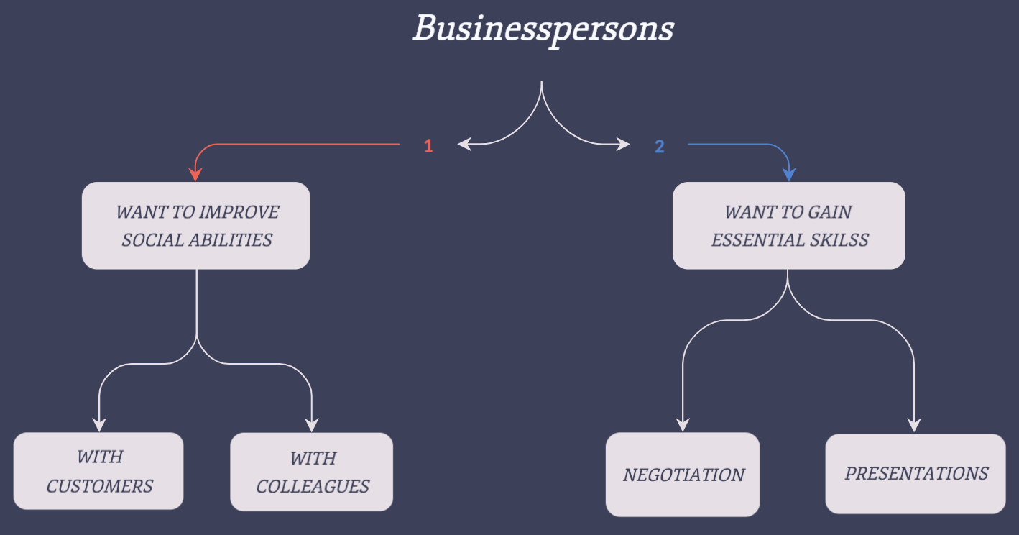
Target Customers
All ages and All genders
Highlighted Group
18 – 35 Years Old
Students & Businesspersons
With similar demands on improving communication skills
Notes:
Whether due to increased awareness or a growing problem remains unclear, but concern around social isolation is on the rise globally. Last January the UK appointed its first minister for loneliness and recent Office of National Statistics data found nearly 10% of 16 to 24-year-olds reported feeling "always or often" lonely.

Slide 8
Product Values
From the point of view of customer’s indispensable demands
High feasibility to implement
High flexibility to develop derivatives
Huge potential market demands
Pioneers in the market – Immature competitors
Indispensable needs from people in different ages

Slide 10
Our Solutions
APP
Easy to implement for users
Relatively low cost to develop
Possibility to create service chain
Cloud service
Create database for government and licensed healthcare organizations in order to help develop better solutions to the Hikikomori phenomenon.

Slide 12
Approaching Channels
Phone App
Free download
One-click register
Free to use anywhere
Web Service:
Customized service
Multiple choices
Government & Hospital Cooperation
Support the research and therapy of related diseases
Charity Philosophy
For every $100 we earned,
$1 will be donated to the funding for communication disorder therapy
Notes:
That’s why I say it has feasibility and flexibility
autism

Slide 14
Cost Structure
Cloud Servers: ~ $1million/yr
Developers: ~ $4 million + bonus $2 million/yr
Office: ~ $1m/yr
Others: ~ $500K/yr
Total cost per year: $1m + $6m + $1.5m → $9m

Slide 16
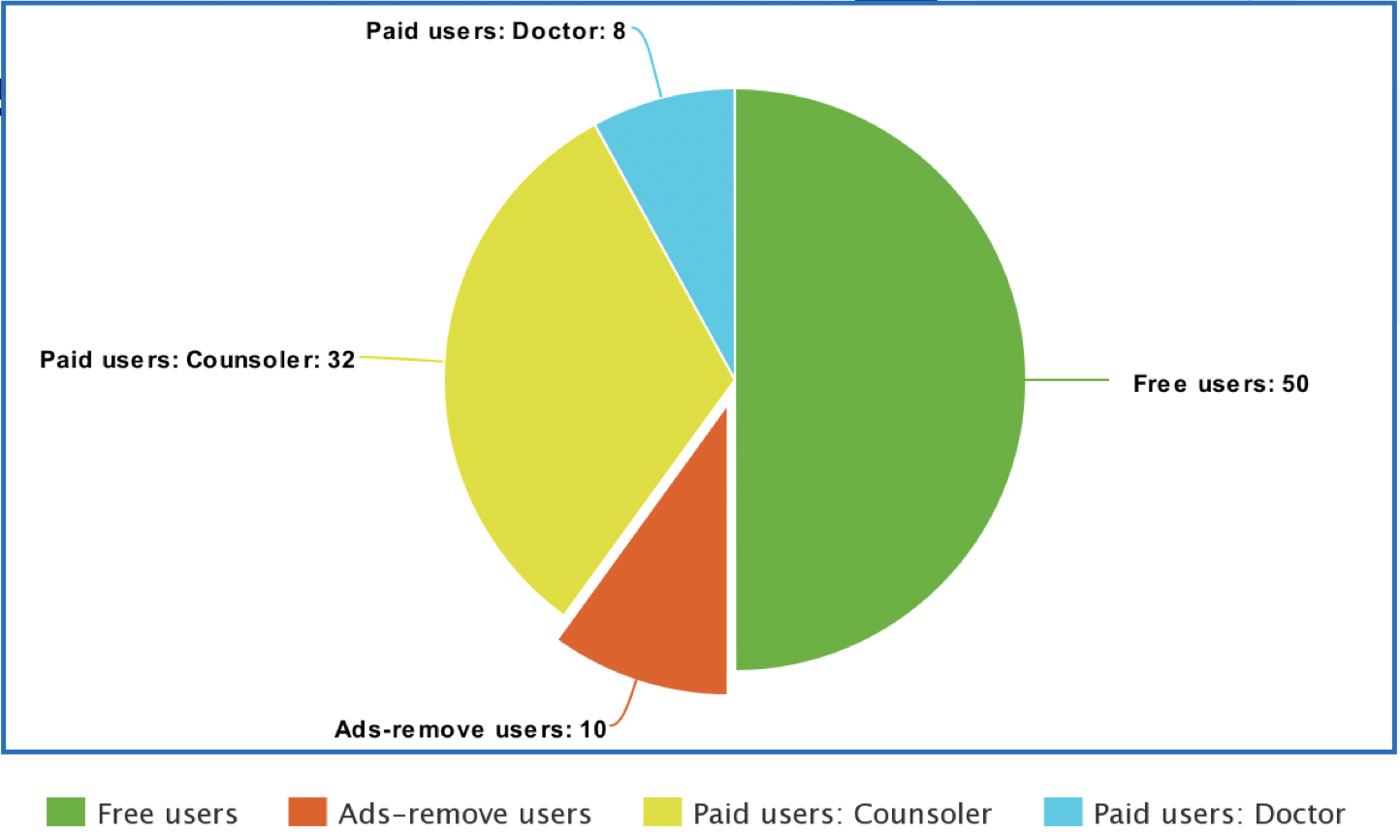
Revenue Streams
1.268 billion * 1.57% → 20 million Hikikomori in Japan
20million * 5% → 1 million users
Customers Structure

Slide 17
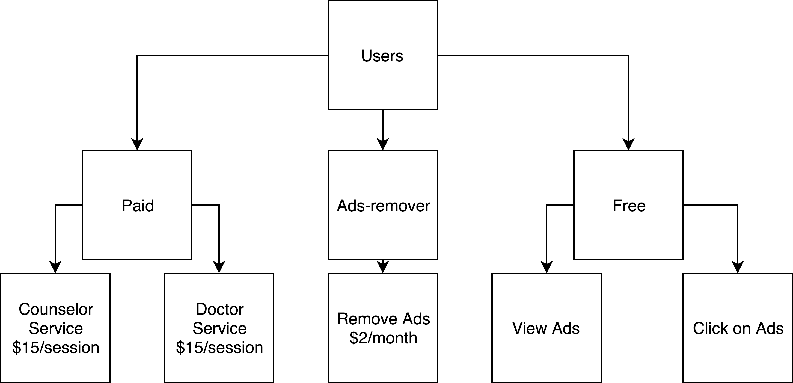
Revenue Streams
Free users: 1 million * 50% → 0.5 million
Click on Ads: 0.5 million * 30% * 1 * 2 → $ 0.3m
View Ads: 0.5 million * 70% * 0.3 * 2 → $0.21m
Revenue: $0.3m + $0.21m = $0.51m
Ads-removed users: 1 million * 10% → 0.1 million
Revenue: 0.1 million * $2 * 12 → $ 2.4m
Paid users: 1 million * 40% → 0.4 million
Counselor service: 0.4 million * 80% * $15 → $4.8m
Doctor service: 0.4 million * 20% * $50 → $4m
Revenue: $4.8m + $4m = $8.8m
Total revenue per year: ($0.51m + $8.8m) * 4 * 12 + $2.4m → $425.31m

Slide 19

Key Members
Product Development
Anton & Ridwan
Sales
Oleksii
Marketing
Bi
Management
Chen
Notes:
International Project for Software Development

Slide 21




Unique Advantages
Speech Analysis
Based on the verbal performance and content validity
State-of-the-art Natural Language Processing technology
Behavioral Capacity
Help with exploring the most suitable postures and appropriate actions
Well developed computer vision techniques
Emotion Cultivation
Create the best communication vibe
In-Society Shared Data
Data exchange and share on the cloud platform with different organizations

Slide 22

Thank You.
CP
Cyberpunkies
“Socialite” by Cyberpunkies

